Slide 1
Health and Safety
Isobel Davies

Slide 2
Learning objectives
Understand risk assessments and how we should use them day to day
Understand manual handling Risk assessments
Learn about the CSP guidelines on Manual handling
Learn about hand washing and infection control guidelines
Learn about PPE
Learn about incident reporting
Health and wellbeing and you

Slide 3
Hazard Vs Risk ?
Hazard Vs risk
  A hazard is something which has the potential to cause harm, for example : a chemical, working at a height or noise
  A risk is the likelihood, whether low, medium or high, of that hazard causing a person harm

Slide 4
Risk assessment
What is risk assessment ?
  A way of identifying hazards in the workplace ad taking steps to prevent harm
Why is it important ?
  To us ?
  To our patients
Every time you see a patient you should complete a mini risk assessment based on your subjective and objective assessments

Slide 5
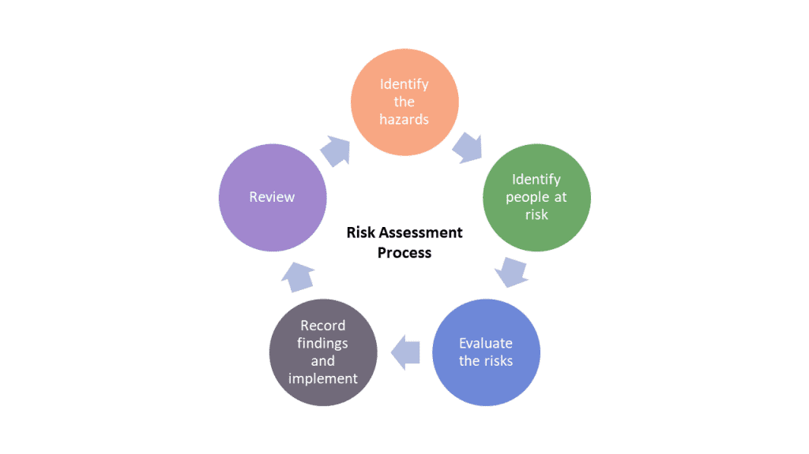
Risk assessment - 5 steps

Slide 6
Manual Handling
Can be both a risk and a hazard if not appropriately assessed
  We have a duty of care to complete appropriate MH
  It comes under both Scope of practice and fitness to practice
  You need to risk assess for both the patient and yourself
  Our risk assessment is used to inform the other members of the MDT who may not have the same knowledge or skills around manual handling or mobilising patients
Let's see what the CSP has to say on the matter

Slide 7
Manual Handling – CSP guidance
"Principle 1.2 of the CSP Code(11) requires that a physiotherapist and associate perform only duties which they are safe and competent to deliver. The development of manual handling skills is based not only on knowledge and training but also on relevant and sometimes specific experience. When considering competence and safety in relation to the manual handling of patients, all physiotherapists must be as realistic and analytically self-critical as they would be in relation to any other aspect of their professional practice. All members are empowered by this rule to say ‘no’ since it provides a rational basis for not proceeding with any task, including manual handling, which they consider to be beyond their competence or ability to work safely."

Slide 8
Manual Handling – CSP guidance
"Principles 3.2 and 3.3 of the code clearly state the responsibility of the physiotherapist in considering the safety of other personnel and their competence in manual handling, addressing the situation by carrying out an appropriate risk assessment and documenting the process, and explaining and engaging the patient in the risk and decision-making processes."
Members of the CSP will be covered by Personal indemnity insurance (See CSP Information paper PD027 Insurance and physiotherapy practice. www.csp.org.uk/ publications/insurance-physiotherapy-practice)
"The PLI scheme covers individual for all activities that are within the scope of physiotherapy practice and this will include manual handling activities."

Slide 9
Manual Handling – The CSP and the law
The law as set out by : The health and safety at work act 1974 and The management of Health and Safety at work regulations 1999
  Your employer should provide you with the adequate training and equipment to safely complete the manual handling you must have to complete to do your job.
  If you haven't received the adequate training you should not be doing the manual handling, if your employer is not fulfilling this it should be escalated to the CSP and a governing body.

Slide 10
CSP guidance on risk assessment
Step 1: Avoidance:
  Any general risk assessment taking place under MHSWR 1999(15) will identify, or should already have identified, the range of hazardous manual handling tasks taking place or likely to take place in a particular department / specialist setting.
  Many of these tasks will not be related directly to patient rehabilitation and every reasonably practicable step must be taken to avoid them.

Slide 11
CSP guidance on risk assessment
Step 2: Risk assessment:
  There is an absolute requirement to assess the risks arising from manual handling operations that cannot reasonably practicably be avoided.
    Such risk assessments may be:
      generic, i.e. pertaining to groups or classes of routinely undertaken or foreseeable but unavoidable tasks such as, for example: routine transfers from wheelchair to treatment table, or the transport of certain items of equipment
      patient-specific, where the generic protocol is not appropriate to a particular patient at a particular time.
  In arriving at Step 2 the physiotherapist has already taken the decision that it is not reasonably practicable to avoid the manual handling task and has moved on to consider the extent of the risk potentially associated with carrying out the task.
    To avoid any doubt:
      Hazard – something (e.g. a circumstance or behaviour) with the potential to cause harm
      Risk – a notional consideration of the likelihood that a hazard will result in harm (to the handler, the patient or anyone else associated with the task) and of the severity or extent of that harm.
  When the guidance was set out in 2004 an acronym was created : TILE

Slide 12
TILE
Task
Eg. Mobilising to and from toilet or sitting on the edge of the bed
Individual
The person carrying out the task i.e : you. This should consider skill set, experience etc
Load
The patient: What is their function, how much help do they need , do they have any behavioural problems eg. Impulsivity or aggression or hypoactive delerium
Environment
The space in which the task is taking place. Taking into account things like footwear, lighting, space to complete task, attachments and any equipment you may need.

Slide 13
Documenting TILE
Should be included in your observation section of your SOAP notes as it part of your assessment
It should also be included in your analysis as a comment on that patients level of function
  Eg :
    O/ A:E assessment
      TILE : Ao1 with Walking stick for mob
      Or
      TILE : Ao3 for t.f with sara steady
    A/ pt admitted to ICU with chest sepsis, in multi-organ failure. Currently off baseline for mobility secondary to prolonged bed rest, requiring heavy assistance of 2 to sit on the edge of the bed. Will require specialised seating to sit out safely.

Slide 14
Manual handling: TILE for yourself
Remember to complete Manual handling with a patient you need consent
Work within the legal framework AKA : in your scope of practice
  Keep up to date with our training
  Know your own limitations
Complete a risk assessment and document it clearly
Communicate your risk assessment to the MDT verbally

Slide 15
Risk assessment: lone working
" Those who work by themselves without close or direct supervision"
Increased risk from assault an accidents
  Employers should:
    Carry out a lone working risk assesment
    Implement a safe system of working- lone working devices
    Policy for lone working, outlining roles and responsibilities
    Provide training for managing violence and aggression
    Support those who have been involved / had a 'near-miss'

Slide 16
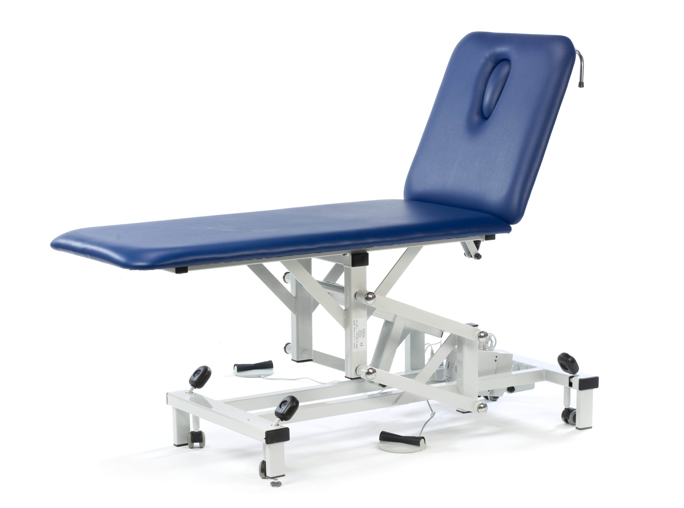
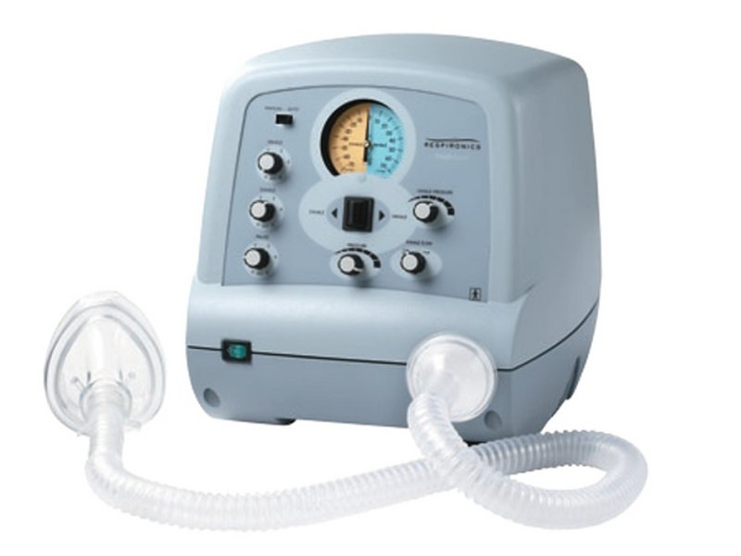
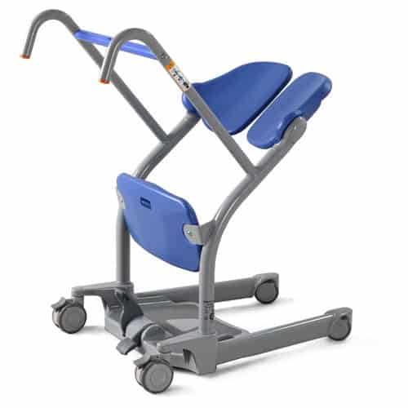
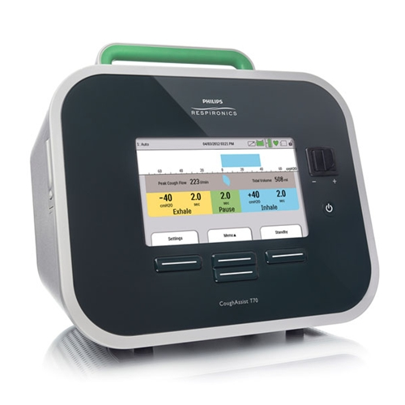
Risk assessment: equipment
Equipment physios can range from :
  Plinths
  Electrotherapy machines or ultrasound machines
  Cough assist machines
  NIV machines
  Mobility equipment : crutches and walking sticks
  Manual handling equipment : hoists and sara steadys
The responsibility here is shared between the therapist and the employer
Must make sure all equipment is regularly serviced
  Insurance
  Safety of the patient
  Safety of the therapist
Make sure that equipment is still recommended in NICE guidelines or local guidelines

Slide 17
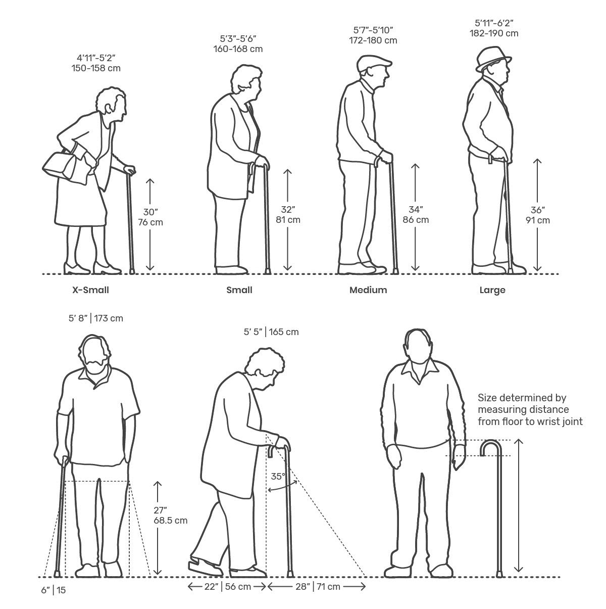

Equipment: giving out walking
Very common therapy intervention often overlooked
Before giving to the patient :
  Check the ferule
  Check the metal shaft / shafts of the aid
  Measure the patient for height modification : the handle of the aid should line up with their ulna styloid process
Documentation :
  The lot number of the walking aid should be included in your documentation as part of the HCPC and CSP standards
  This means that if the aids in that lot are recalled there is a record of who was given them

Slide 18
Scope of practice
Part of health and safety is remembering to work within your scope of practice
Recognise and highlight if you do not feel prepared to do something / have never done something before

Slide 19
Infection control
Hand washing
Clothing, watches, jewlery etc
PPE :
  Standard ppe
  Covid ppe

Slide 20
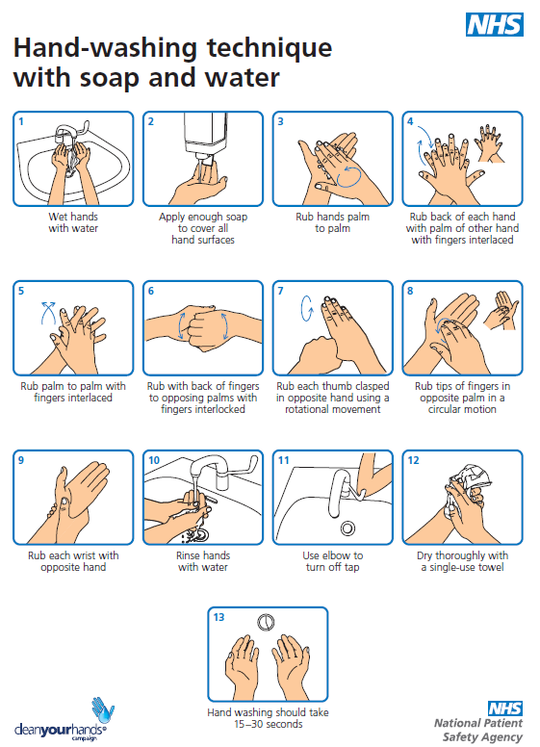
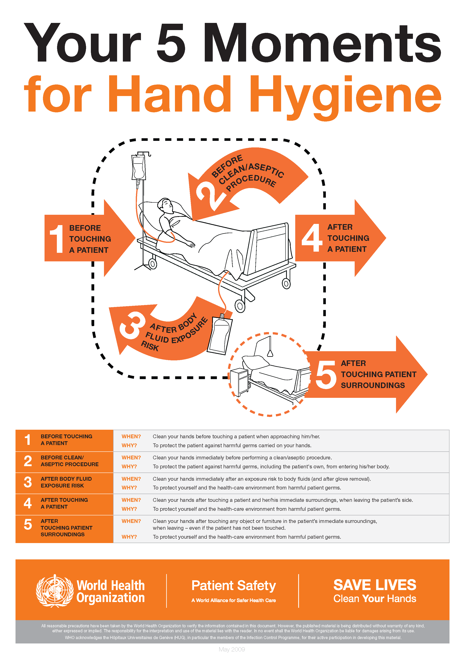
Hand washing How to wash your hands | NHS - YouTube

Slide 21
Preparing for a clinical environment
Uniform //
  not travelling in uniform
  Ensuring that uniform is clean on everyday
Bare below the elbows
Jewlery
  Plain band only
  Religious or medical Jewlery can be worn
  No watches or activity trackers
  Earrings : trust policy varies but generally small studs only
  No necklaces
Hair off the collar

Slide 22
PPE
Standard PPE
  Gloves off campaign
  Gloves and apron for contact with bodily fluids
COVID and other infectious diseases
  Gowns
  Gloves
  Visors
  FFP3 masks
  Reusable masks
  COVID-19: Donning and doffing of Personal Protective Equipment in Health and Social Care Settings - YouTube

Slide 23
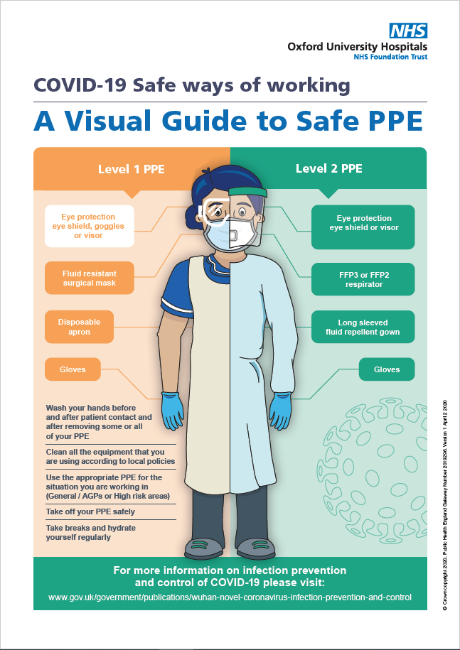
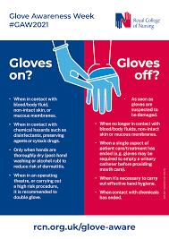

Slide 24
Incident reporting
Escalate
Report near misses
No blame culture / culture of reflection and learning

Slide 25
Incident process
Incident occurs
Escalate to medical team and manager
Investigation into incident
Reflection and analysis
Plan and complete appropriate changes
Report incident on formal system

Slide 26
Health and wellbeing : looking after you
Part of fitness to practice is ensuring you are physically and mentally able to care for your patients
  Reporting injuries to your line manager
  Reporting long term/ chronic conditions to occupational health
  Skin and hand health through occupational health
  Vaccinations
  Safe practice at work to protect your own health : PPE, hand hygiene, safe manual handling
  Recognising changes in your mental health
  Having a good work life balance

Slide 27


Mental health
"822,000 workers suffering from work-related stress, depression or anxiety (new or long-standing) in 2020/21."
Recognise changes in your own mental health and address them with whoever you feel safe disclosing this to
Self-referral to Mental health services through the NHS: talking therapies
Private companies : private healthcare or apps like better help

Slide 28
Recognising mental health changes
Anxiety :
feel tired, on edge, restless or irritable
feel a sense of dread
be unable to concentrate or make decisions
have trouble sleeping
feel sick, dizzy, sweaty or short of breath
be shaky or trembly
get headaches or tummy aches
avoid situations or put off doing things you are worried about
have difficulty falling or staying asleep
experience a noticeably strong, fast or irregular heartbeat
have pins and needles
have a dry mouth
sweat excessively
repeatedly check things or seek assurance from others
Depression :
Feeling low may cause someone to stop doing the things they like, cut themselves off from loved ones or have difficulty sleeping. Other signs include feeling:
sad
worried, anxious or panicked
tired
less confident
frustrated, irritated or angry
Burnout :
feel overwhelmed
have racing thoughts or difficulty concentrating
be irritable
feel constantly worried, anxious or scared
feel a lack of self-confidence
have trouble sleeping or feel tired all the time
avoid things or people you are having problems with
be eating more or less than usual
drink or smoke more than usual

Slide 29

Self-care
Not just having a bath with a glass of wine and a facemask
Self – care is anything that helps to balance your mood :
  Exercise or moving your body : doesn't have to be vigorous
  Being out in nature
  Reflecting or journaling
  Hobbies
  Taking regular annual leave
  Taking time away from technology and social media

Slide 30
References
(no date) NHS choices. NHS. Available at: https://www.nhs.uk/every-mind-matters/mental-health-issues/ (Accessed: November 1, 2022).
Guidance on manual handling in Physiotherapy (4th edition) (no date) The Chartered Society of Physiotherapy. Available at: https://www.csp.org.uk/publications/guidance-manual-handling-physiotherapy-4th-edition (Accessed: November 1, 2022).
(no date) NHS choices. NHS. Available at: https://www.nhs.uk/live-well/best-way-to-wash-your-hands/ (Accessed: November 1, 2022).
Work-related stress, anxiety or depression statistics in great ... - hse (no date). Available at: https://www.hse.gov.uk/statistics/causdis/stress.pdf (Accessed: November 1, 2022).

Slide 31
Questions

